Slide 1
Cloud-Based Logging and Monitoring
Joe Partlow
ISSA South Florida 2015

Slide 2
$whoami
Joe Partlow (jpartlow@reliaquest.com) – CISO, ReliaQuest
Been in the IT and information Security industry for 15+ years and has experience in Operations Management, Information Security, Network Security, Systems Design, Risk Assessment, Database Administration, Network Infrastructure, Web Application Development, Systems Design & Integration and Project Management.
I just spend a lot of time playing around with SIEM and logging!

Slide 3

Audience poll:
Who currently manages logging and monitoring at work? End Users of a SIEM?

Slide 4
Why do we need logging?
Central Logging and Monitoring allows you to consolidate the million log sources you have in one spot and potentially perform light correlation across all the various log sources.
Compliance tells us we have to…
Every mandated compliance regulation has some level of requirement (as well as monitoring them, not just collecting)
Just because your servers are hosted elsewhere, doesn’t mean you aren’t responsible for them!
You can’t defend against things you can’t see.
For Incident Response - Try searching across each individual server’s event logs for all activity from a particular timeframe
Manually reviewing logs is not feasible, we need to collect and monitor them centrally.

Slide 5
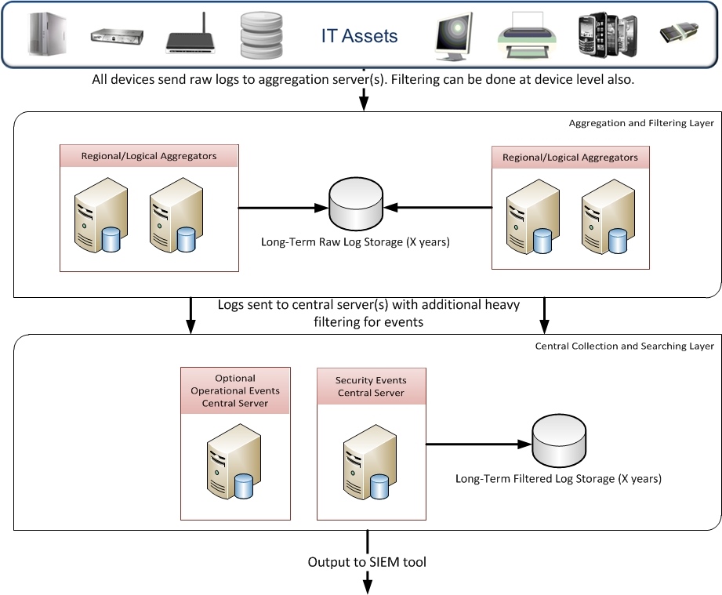
Enhanced Logging Model

Slide 6
Types of Environments
There are many different ways you can divide up your infrastructure and many times you don’t have a choice due to mergers, acquisitions, rapid growth, etc.
Totally in the cloud – Everything is rainbows and kittens since nothing bad happens in the cloud (because they’re fluffy)
Everything managed in local a network you control – It’s all mine!
Some evil hybrid of the two – Web sites or public facing services in the cloud (or remote branch offices/data centers) and back office functions in your own data center. This model also may work well for distributed enterprises with remote offices or data centers.

Slide 7
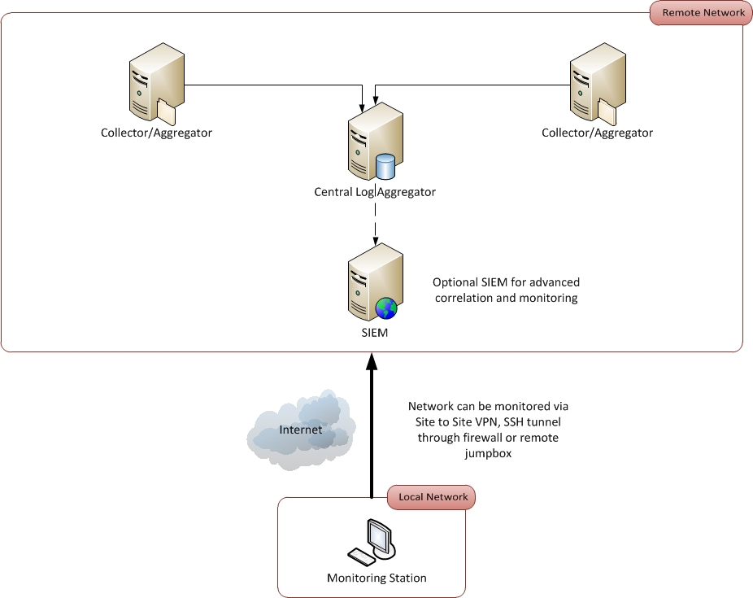
Everything in the Cloud

Slide 8
Everything in the Cloud – Cont.
Logging Options – How can we get visibility into what is happening up there?
Since all the logging is self-contained in the remote network, it’s typical to just remote in via jump box or VPN connection to the logging tool interfaces from your remote corporate office.
Make sure you allow for plenty of data storage in your plan for long-term log retention. Not as easy to just archive off to a few TB usb drive…

Slide 9
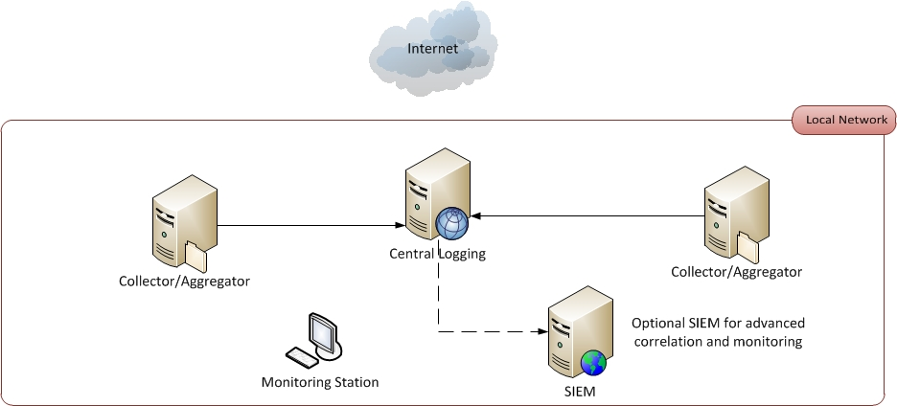
Everything in local network

Slide 10
Everything in local network – Cont.
Logging Options – This is the traditional model where you have access to a management network where all the logging tools reside and can just pull up the interfaces locally.
Easiest option since you have physical control to all devices and logging tools

Slide 11
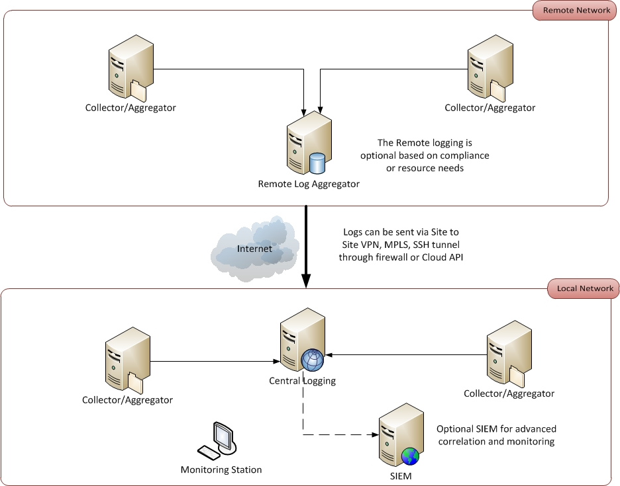
The Hybrid

Slide 12
The Hybrid – Cont.
Logging Options – How can we get visibility into what is happening up there and internally? This is where it gets a bit trickier since you have to get all the logging data combined in a centralized location first. Some questions you will need to answer:
Where will the logging tools reside? Depends on where the majority of the data is. It’s more efficient to have the collection tools doing the filtering and aggregating as close to the source as possible.
Compliance may dictate where the data has to live. EU, France, Germany, etc. all have strict laws against exporting potentially sensitive PII data.
How big are the external pipes? May be more cost effective to keep data at both places and just combine the alerts to a central SIEM or monitoring tool.
There may a logical split in your organization to make this more feasible (ie. Separate, distinct corporate divisions or business units.
This model also works for remote data centers or offices connected via MPLS or site to site VPN.

Slide 13
Cloud Infrastructure Logging
In additional to the standard Operating System or application logs from the servers, many essential “behind the scenes” logs should also be gathered and monitored for unauthorized/malicious activities.
Performance and configuration auditing can assist your SOC analysts by alerting over existing baselines to assist in looking for abnormal conditions.

Slide 14
How to get visibility to AWS
CloudTrail – Set up what items you want to log
Logs all API call to the environment from the console API or CLI within 15 mins
Archive or purge based on custom settings
Can aggregate logs from multiple instances and regions
RESTful API to pull into other tools
AWS CloudWatch tool can alert off of them as well
CloudWatch – Used for real-time events and from CloudTrail logging
Tracks performance on individual instances (CPU, disk, load balancer latency, memory, traffic etc.)
Mobile console or Agent for viewing logs
Set Alarms to notify you of events – checked every 5 minutes and can also stop or recover an instance
Create reports and dashboards in the console or use API to integrate to other tools
Can also monitor billing and auto scaling options.

Slide 15
How to get visibility to AWS – cont.
CloudTrail – What can we get?
Starting or stopping of an instance
Creation or deletion of Users in AWS
Sign in events
Log contains the following main information:
Time request occurred
User that make the request
Service that made the request
Source IP and AWS region that handled the request
Error messages and codes
Request parameters and elements
Event ID and Type

Slide 16
How to get visibility to AWS – cont.
Send logs via HP Smart Connector in 3 easy steps!
Have to use powershell and export the logs since AWS doesn’t support Oauth
Grab from here: https://aws.amazon.com/tools/
Install and setup JSON FlexConnector on a VM and point to the folder where your downloaded logs are.
Create destination in Smart Connector to HP Logger, syslog server, or separate SIEM
Good example here: http://akbarov.blogspot.com/2014/08/amazon-web-services-aws-and-arcsight.html

Slide 17
How to get visibility to Azure
Azure Management Portal – Quick portal to see metrics and dashboards
Minimal Mode - CPU, Network stats, Disk stats (sampled at 3 minute intervals)
Verbose Mode – Adds ability to get data from within instances
Increased storage so plan accordingly!
Only stored in storage account for 10 days
Aggregated in 5 minute, 1 hour and 12 hour increments
Can create alerts for the Management Portal for certain metrics
Diagnostics – Used for logging Cloud Services and VMs
Included in Azure SDK
Can get info from:
IIS, Diagnostic stats, Windows Event Logs, Performance Counters, Crash Dumps, .net event sources or custom error logs
Enabled in Services or VMs by using Visual Studio & Powershell
Can enable remote debugging

Slide 18
What else should we get?
Now that we have our Windows event logs, syslog and cloud infrastructure logging in, other types of logs are important as well:
Applications – In-house operational apps, HR, billing, manufacturing, etc.
Windows protections – HIDS, AV, EMET, Applocker
Weblogs - IIS, Apache, etc. - Poor man’s WAF ☺
Databases – User Auditing has disadvantages, customize what to get pulled and logged.
MDM – Many users using mobile devices on the network, restrict and monitor via MDM or at least DNS.
SNMP config data – Performance data might overwhelm but could be aggregated with OSSEC or Nagios…
Cisco UCS API – better than SNMP ☺
VOIP servers – Asterisks etc…

Slide 19
What else should we get? – cont.
DNS/DHCP logs
OpenDNS API makes this easy as well.
SQL Server DMV - (Dynamic Management Views) for advanced SQL data (mirroring, Full-Text Search, Filestream/filetable etc.)
Web Servers:
LogParser.exe -i:W3C -o:CSV
SELECT *,EXTRACT_EXTENSION(cs-uri-stem) As Extension
INTO @10.1.1.1 FROM c:\inetpub\logs\LogFiles\W3SVC1\*
WHERE (cs_uri_query like '*--*') OR
(cs_uri_query like '*\'*') OR
(Win32-Status >= 500) OR
(win32-status = 200 and sc-bytes > 2000) OR
(win32-status = 200 and Extension not in ('aspx','html','js','css','txt’)
Forensics forums are another great source of what to log

Slide 20
My god, it’s full of stars!
Now that we have an idea of all the log sources we can get and how we are going to get it from our environment, how are we going to manage it?
Don’t get overwhelmed! Focus on each source one at a time to filter/aggregate extraneous logs (debug/informational level, non-essential or flooding windows event IDs, etc.)
Many good tools for this:
MS LogParser
Syslog-NG
Splunk
HP Logger/Smart Connectors
ELK (Elasticsearch for indexing, Logstash for collecting and parsing, and Kibana for visualization)
Snare

Slide 21

Thanks for supporting ISSA! Questions?
For more information:
Web: reliaquest.com | Twitter: @reliaquest

